Slide 1
J K K NATTRAJA COLLEGE OF ENGINEERING AND TECHNOLOGY
TEAM MEMBERS:
T.AARTHI
C.CHITRADEVI
R. DIVYA
E.DURGA
MENTOR:
MURUGASHANKAR S

Slide 2
CUSTOMER SEGMENT USING DATA SCIENCE:
ABSTRACTION
Customer segmentation is the process of dividing customers into groups based on their behavior, demographics, and other characteristics. Data science techniques can be used to analyze customer data and identify patterns and trends that can help businesses make more informed decisions about how to market and sell their products or services.

Slide 3
Problem Statement:
Customer segmentation is a critical task for businesses to effectively target their marketing efforts, personalize customer experiences, and optimize business strategies. However, traditional segmentation approaches often rely on limited variables and fail to capture the complex patterns and nuances in customer behavior. There is a need for an innovative data science solution that can provide more accurate and actionable customer segments

Slide 4
Description:
Using data science, we analyze customer data to identify distinct segments based on characteristics and behaviors. We create profiles for each segment, enabling personalized marketing and product strategies. Continuous monitoring and adaptation ensure effective customer engagement and business growth. This data-driven approach enhances customer satisfaction and profitability.

Slide 5
Objectives:
Customer segment objectives include:
Targeting: Identify and reach specific customer groups with tailored marketing.
Personalization: Customize products and services to meet segment needs.
Retention: Increase customer loyalty and reduce churn within segments.
Profitability: Optimize revenue by catering to distinct customer preferences and behaviors.

Slide 6
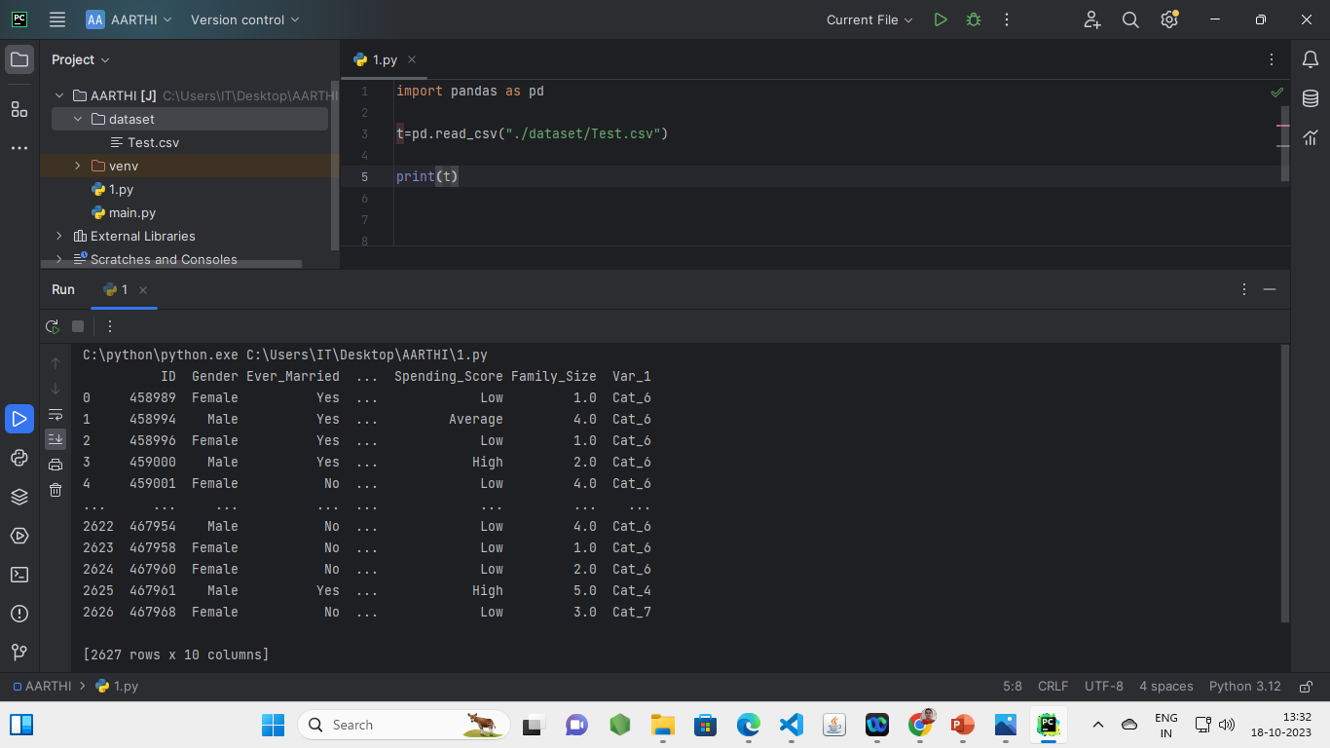
Programming code before preprocessing:

Slide 7
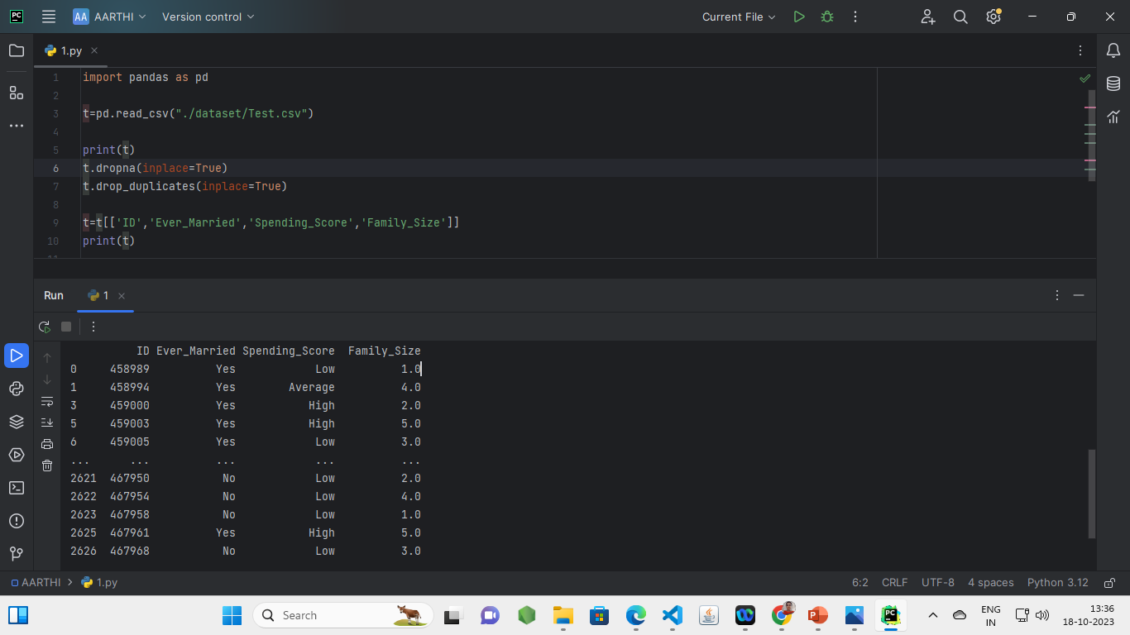
Programming code after preprocessing:

Slide 8
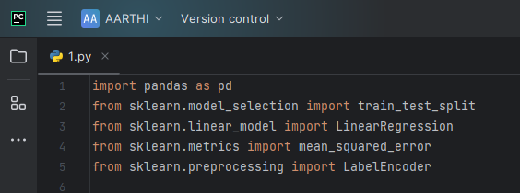
IMPORTING TEST PACKAGES:

Slide 9
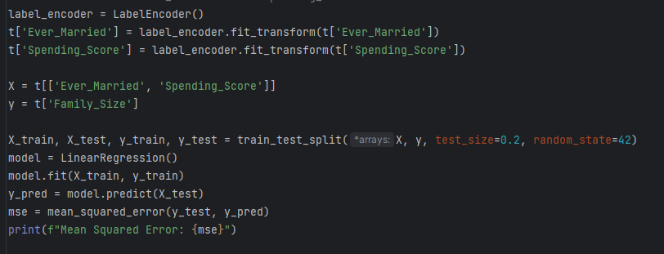
CODE:

Slide 10
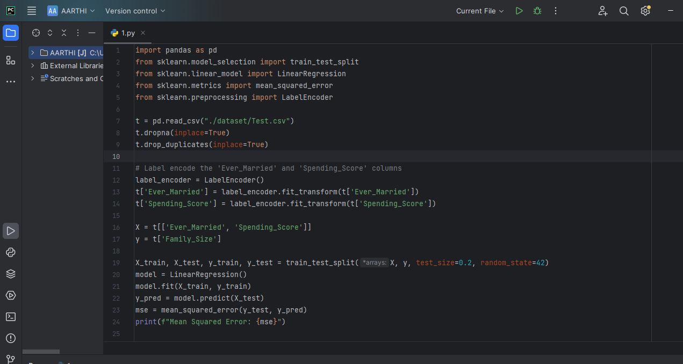
ENTIRE CODE:

Slide 11
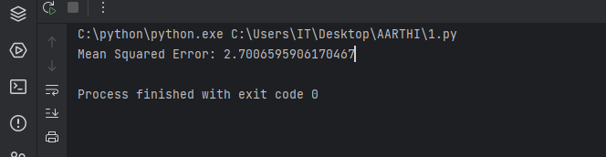
OUTPUT:

Slide 12
Source:
Customer Segmentation using Data Science with the use of Kaggle.
Used software for programming:
Pycharm with installed Pandas.

Slide 13
Help
GITHUB LINK
GITHUB
For more information refer readme file
Readme

Slide 14
Thank you…

